Slide 1
SOCIAL MEDIA TOURISM
(CAPSTONE PROJECT – PRESENTATION)
- By: Shubhank Katarey

Slide 2
Business Problem Understanding
Business Problem: An aviation company collaborated with social networking platforms to analyze the social and digital behavior of the customers, so that they can provide the digital advertisement on the user page of the targeted customers who have a high propensity to take up the product. By using this approach of reaching out to more customers, company wants to increase it’s customer base and this approach will also result in better digital presence which will lead to better revenue generation for the company.
Objective: To predict the customer propensity of buying tickets based on their several activities and behavior on social networking platforms and their preferred device (mobile or laptop) to login.
Scope: Create various predictive models separately for mobile and laptop users, and finalize the best optimized model that will give us the required and useful business insights.

Slide 3
Basic details and EDA
Type of problem: The given business problem is a classification problem (supervised learning category) where the inputs and the target variable are predefined.
Shape of the dataset: The dataset has 11760 rows and 17 columns including the target variable.
Target Variable: The target variable is Taken_product with values Yes and No.
Null/Missing Values: After dropping rows (1431, around 12%) which had null values and special character and two columns (User_id and MA_comment_on_CP), we left with 10455 rows and 15 columns.
Duplicate Rows: Identified 848 duplicates and dropped those all, and now left with 9607 rows.
Outliers and its treatment: Identified 10% of the data as outliers in the dataset, and were treated using quantile based capping (at 90%) and flooring (at 10%) method. Hence, the improvement in the skewness was also observed after treatment of outliers.
Multi-collinearity: The variables are not highly correlated with each other. However, moderately correlation was observed between few variables.
Separate Dataset: The dataset was then split into two different datasets based on preferred device.
Data Encoding: Since the categorical variables are less, data encoding was done using one-hot encoding method.
Shape of each dataset: The ‘data_laptop’ has 1108 rows & 17 columns, and ‘data_mobile’ has 8499 rows & 20 columns.

Slide 4
Modelling Approach used
As it is a classification problem, I have build several models like Logistic Regression, Linear Regression, Naïve Bayes, K-Nearest Neighbor, Random Forest, then ensemble techniques were applied wherever required.
Applied normalization (MinMaxScaler) on independent variables of train set and test set with similar parameters.
Two separate datasets have been formed. The Dataset ‘data_laptop’ has 1108 users who preferred laptop and ‘data_mobile’ has 8499 users who preferred mobile.
Need of applying SMOTE : Out of 1108 laptop users, 832 laptop users (75%) has not taken the product and only 276 users (25%) has taken the product. Similarly, out of 8499 mobile users, 7221 (85%) has not taken product and only 1278 users has opted for it. This means that there is class imbalance in the dataset, where 1 is minority class and 0 is in majority class.
We chose to split the data into train and test set in 70:30 ratio to get the more data in the train set for better classification model.

Slide 5
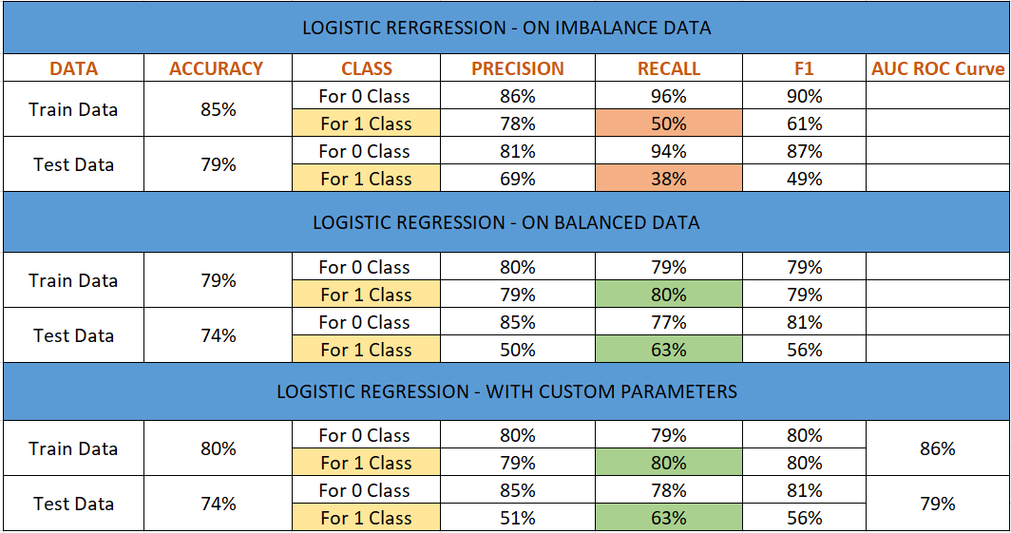
Model building – for laptop
LOGISTIC REGRESSION : Not much difference was after observed using GridSearchCV.

Slide 6
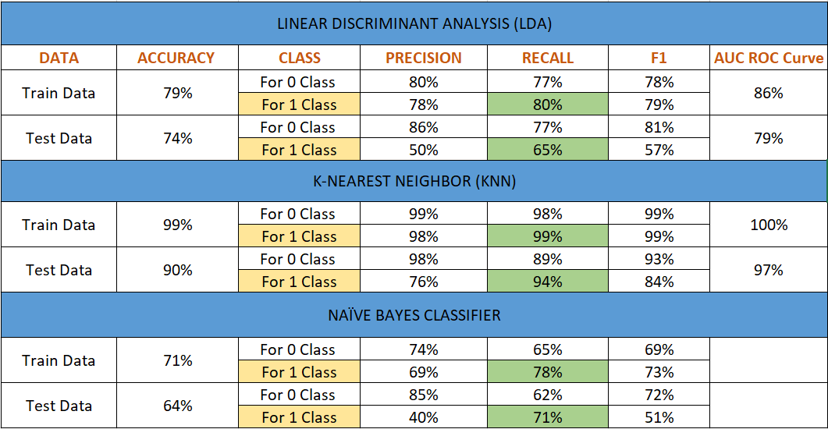
Model building – for laptop…(continue)
LDA, KNN and NAÏVE BAYES Models:

Slide 7
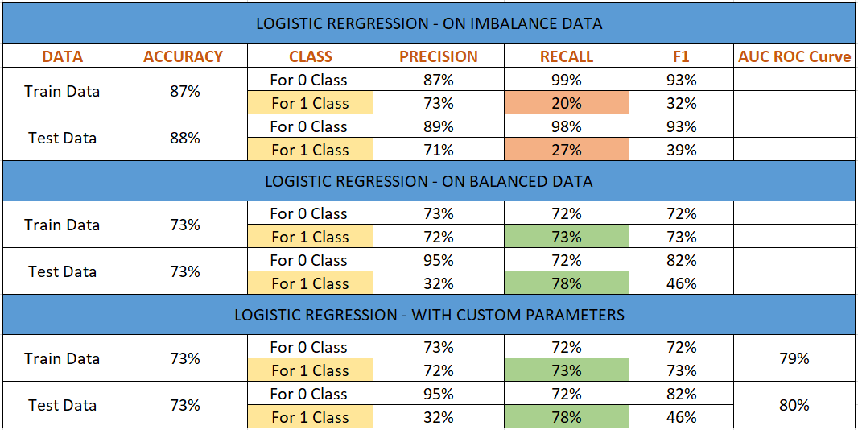
MODEL Building – for mobile
LOGISTIC REGRESSION

Slide 8
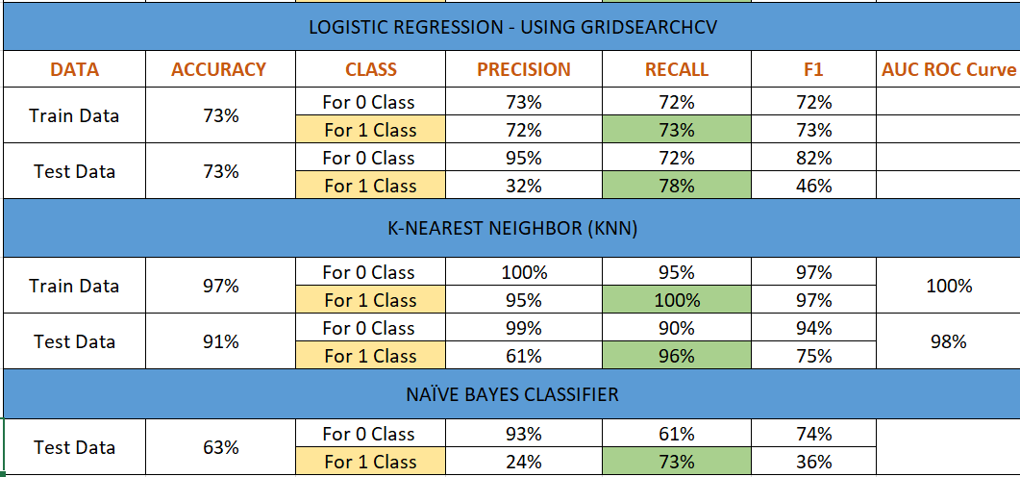
Model building – for mobile…(continue)
Logistic Regression using GridSearchCV, KNN, Naïve Bayes Models:

Slide 9
Final and best predictive model
As we have seen that in the model for laptop users, the Logistic Regression did not perform very well and the predictions were not quite accurate even after using the GridSearchCV with the best parameters.
Same happened in the case of Linear Discriminant Analysis, the accuracy of the model on the test data for the minority class 1 was 74% which can be considered as good but the other measures like precision and recall were 50% and 65% respectively, due to which this model also cannot be considered as a good predictive model.
I have also build models like Naïve Bayes, Random Forest, with different ensemble techniques like bagging, boosting but either the accuracy or the recall values for the minority class 1 was very less and it indicates that the model is not able to predict well about the distribution classes.
But in the case of KNN model, the performance on the test set was quite impressive and we can see that the accuracy is 90% and the recall values are also good, along with AUC ROC value is 97% for the test data, which is very good for the predictive models.
So, for the laptop, we are choosing KNN model as the best predictive model.
Same in the case of mobile, after comparing all the model performances, I chose KNN as the best predictive model.

Slide 10
Business insights and recommendations
The data shows that most of the customers are not very interesting in buying the product. It has also been observed that the customers who has ‘adventure and tourism’ as their preferred place to visit has less chances of buying the product.
There might be the reason that either the customer did not like the services in the past or he/she is opting for other products which might be giving good offers to the users.
But one thing the company can focus on is that the customers who are following the company page have more chances of buying the product, and the majority of the customers who do not follow the company page are not taken the product.
Also, the users who use mobile as their preferred device to login are more in comparison to users who use laptop, irrespective of whether the person is adult or not.
The company should focus more on the people who spend more number of daily average minutes on company page, because these kind of users might be interested in the product and looking for travel related services and offers. The company should target such users as the chances are high.
There are users who are not working have not taken the product very often as they might not getting the best offers they are looking for, or due to high cost of the services.
The company should focus on improving it’s services and provide best offers to customers, so that the customers who once opt for the product, do not switch to some other companies.

Slide 11
~ THE END ~

